Slide 1


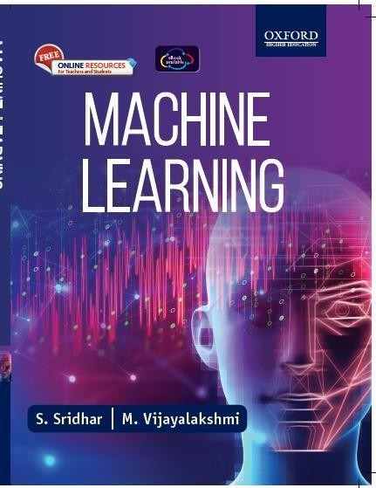
Machine Learning
S. Sridhar and M. Vijayalakshmi

Slide 2
Chapter 1
Introduction to Machine Learning

Slide 3
Need for Machine Learning?
BUSINESS ORGANIZATIONS HAVE NUMEROUSDATA
NEED TO ANALYZE DATA FOR TAKING DECISIONS
High volume of available data to manage
Cost of storage has reduced: capture, process, store, distribute, and transmit the digital information.
Availability of complex algorithms now.

Slide 4
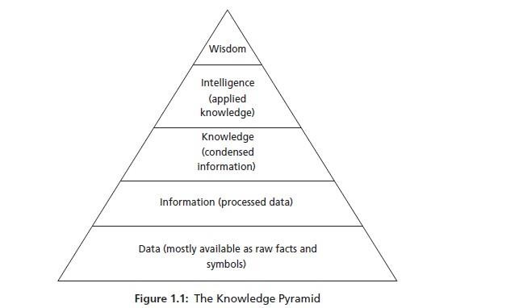
Need for Machine Learning?

Slide 5
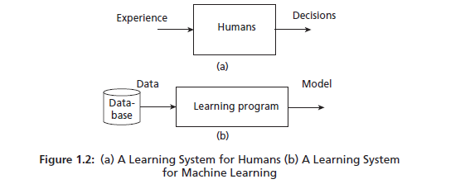
What is Machine Learning?
“MACHINE LEARNING ISA FIELDOF STUDY THAT GIVES THECOMPUTERS TO LEARN WITHOUTBEING EXPLICITLYPROGRAMMED”
Y=f(x), f is the learning function that maps the input x to output y. Learning of
function f is the crucial aspect of forming a model in statistical learning.

Slide 6
What is a Model?
A MODEL CAN BE ANY ONE OF THE FOLLOWING –
MATHEMATICAL EQUATION
RELATIONAL DIAGRAMS LIKE GRAPHS/TREES
LOGICAL IF/ELSE RULES
GROUPINGS CALLED CLUSTERS

Slide 7
TOM MITCHELL DEFINITION OF MAC HINE LEARNING
“A computer program is said to learn from experience E, with respect to task T and some performance measure P, if its performance on T measured by P improves with experience E.” The important components of this definition are experience E, task T, and performance measure P.

Slide 8
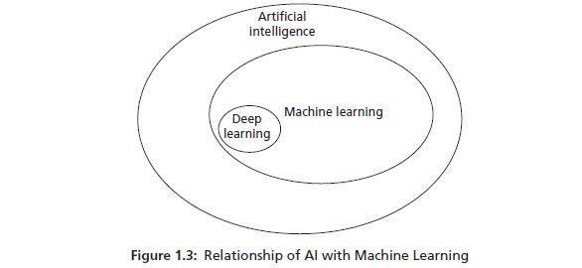
Machine Learning and AI
RELATION BETWEEN MACHINE LEARNING AND AI

Slide 9
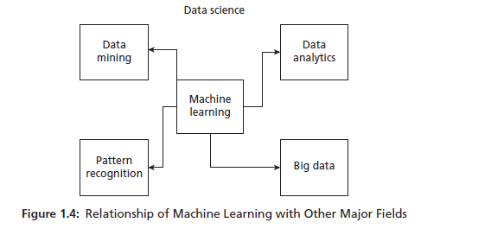
Machine Learning and Data Science
DATA SCIENCE IS AN “UMBRELLA TERM” COVERING FROM DATA COLLECTION TO DATA ANALYSIS.

Slide 10
Machine Learning and Data Science
CHARACTERISTICS OF BIG DATA
Big data is a field of data science that deals with data’s following characteristics:
Volume: Huge amount of data is generated by big companies like Facebook,
Twitter, YouTube.
Variety: Data is available in variety of forms like images, videos, and in
different formats.
Velocity: It refers to the speed at which the data is generated and processed.

Slide 11
Machine Learning and Data Science
Data Mining
Data mining’s original genesis is in the business
Data Analytics: aims to extract useful knowledge from crude data
Pattern Recognition: It uses machine learning algorithms to extract the features for pattern analysis and pattern classification.

Slide 12
Machine Learning and Statistics
It is mathematics intensive and models are often complicated equations and involve many assumptions.
Statistical methods are developed in relation to the data being analyzed

Slide 13
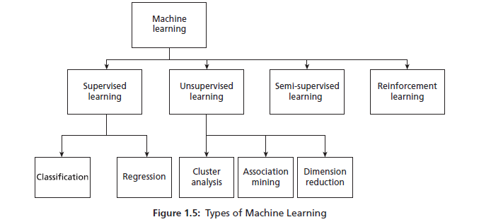
Machine Learning Types

Slide 14
Labelled Data
Data is a raw fact.
Data is represented in the form of a table.
Data also can be referred to as a data point, sample, or an example.
Each row of the table represents a data point.
Features are attributes or characteristics of an object.
Columns are attributes. Out of all attributes, one attribute is important and is called a label

Slide 15

Unlabelled Data
DATA THAT ISNOT ASSOCIATED WITHLABELS ISCALLED UNLABELLED DATA.

Slide 16
Supervised Learning
Supervised algorithms use labelled dataset.
There is a supervisor or teacher component in supervised learning.
A supervisor provides labelled data so that the model is constructed and generates test data

Slide 17
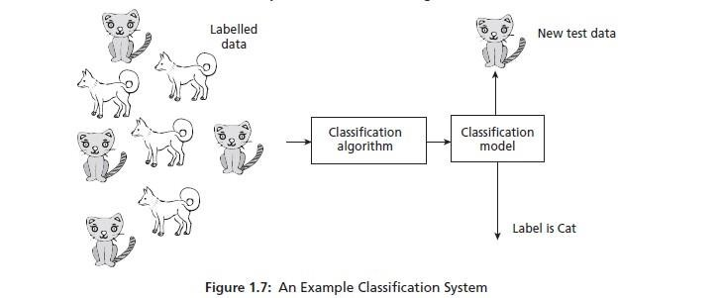
Supervised Learning
Supervised learning has two methods:
Classification
Regression

Slide 18
Supervised Learning
The input attributes of the classification algorithms are called independent variables.
The target attribute is called label or dependent variable.
The relationship between the input and target variable - classification model. In classification, learning takes place in two stages.
Training stage, the learning algorithm takes a labelled dataset and starts learning. After the training set, samples are processed and the model is generated.
Constructed model is tested with test or unknown sample and assigned a
label. This is the classification process.

Slide 19
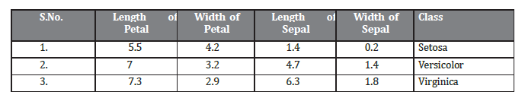
Supervised Learning

Slide 20
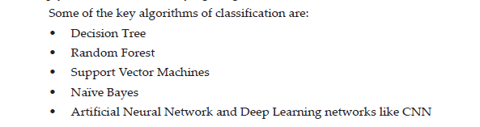
Supervised Learning
KEY ALGORITHMS

Slide 21
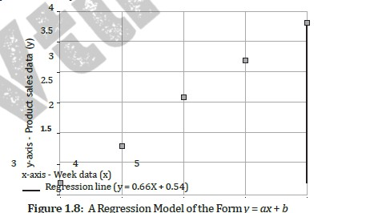
Supervised Learning
REGRESSION ALGORITHMS
The regression model takes input x and generates a model in the form of a fitted line of the form y = f(x).
Here, x is the independent variable that may be one or more attributes and y is the dependent variable

Slide 22
Unsupervised Learning
learning is by self-instruction.
There are no supervisor or teacher components.
In the absence of a supervisor or teacher, self-instruction is the most common kind of learning process.
This process of self-instruction is based on the concept of trial
and error

Slide 23
Unsupervised Learning
Cluster Analysis
group objects into disjoint clusters or groups.
Clusters objects based on its attributes.
All the data objects of the partitions are similar in some aspect and vary from the data objects in the other partitions significantly.

Slide 24
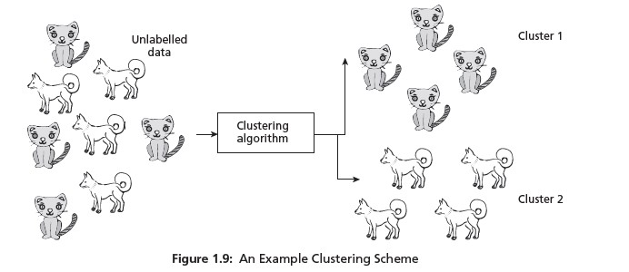

Slide 25

Unsupervised Learning
KEY ALGORITHMSOF UNSUPERVISED LEARNING

Slide 26
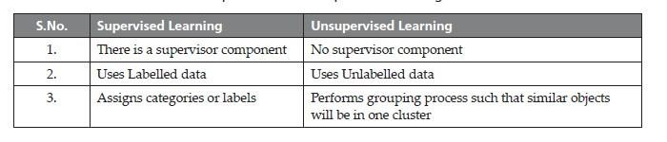
Key Differences

Slide 27

Semi-supervised Learning

Slide 28
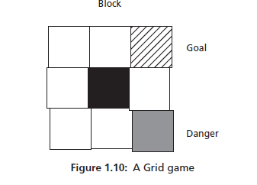
Reinforcement Learning
Reinforcement learning mimics human beings.
Allows the agent to interact with the environment to get rewards.
The agent can be human, animal, robot, or any independent program. The rewards enable the
agent to gain experience. The agent aims to
maximize the reward.
The reward can be positive or negative (Punishment). When the rewards are more, the behavior gets reinforced and learning becomes possible.

Slide 29
Challenges of Machine Learning
Problems –
Huge data –
High computation power .
Complexity of the algorithms –
Bias/Variance – Variance is the error of the model..

Slide 30
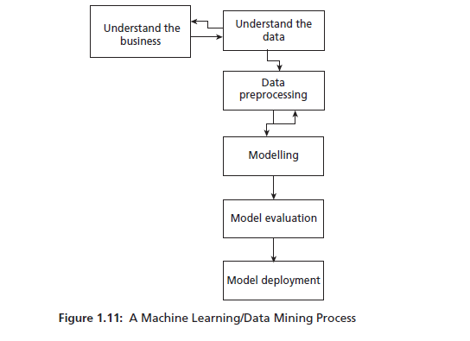
Machine Learning Process
MACHINE LEARNING/DATA MINING PROCESS
CRISP-DM stands for Cross Industry Standard Process – Data Mining

Slide 31
Machine Learning Applications
MACHINE LEARNING MAJOR APPLICATIONS
Sentiment analysis: NLP words of documents are converted to sentiments
like happy, sad, and angry.
Recommendation systems – These are systems that make personalized
purchases possible.
Voice assistants –Amazon Alexa, Microsoft Cortana, Apple Siri, and Google Assistant are all examples of voice assistants. They take speech commands and
perform tasks.
Technologies like Google Maps and those used by Uber are all examples
of machine learning which offer to locate and navigate shortest paths to reduce time.

Slide 32
